Slide 1



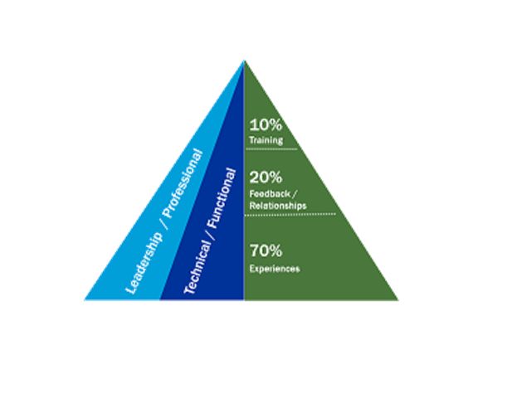


HR Sharepoint
Our People
Recognition Program
Questions about ACE, click in the image
Start a Review with your direct report
https://connect.baxter.com/sites/functions/HR/MyCareer/Pages/ACE.aspx
https://www.myworkday.com/baxter/d/home.htmld
https://worksites.baxter.com/sites/GTCm/rewards/Pages/default.aspx
New Resource
Step 1 How to créate a position (Contractor)
Step 2 How to créate a profile (Contractor)
Talent and Performance Workday Guide
Recognize a colleague or a Manager who cares,
click on the image
First time accessing Human Eland
Review your Payslip, click on the image
https://connect.baxter.com/sites/functions/HR/MyCareer/Pages/Development-Planning-&-Actions.aspx
Create your Development Plan
Navigate in the Baxter Talent Dev Framework, Click on the image
https://connect.baxter.com/sites/functions/HR/MyCareer/Pages/Performance-Goals.aspx
How to create your Goals Plan

Slide 2

Question about your Payroll (Email to Alfredo Hidalgo and Eduardo Torres)
Need an External Training (Email to Eduardo Torres)
Need a Job letter (Email to Alfredo Hidalgo and Eduardo Torres)
Subscribe to Stock Purchase program (https://corpserviceshome.etrade.com/e/t/olen/OLENEsppLogin?vanity=enroll)
Question about Purchasin Program (Email to Gustavo Alvarado and Eduardo Torres)
Need HR documents (additionals or replacements) i.e. Food and Restaurant card, Compnay ID,
(Send email to Alfredo Hidalgo and Eduardo Torres)
Question about Company Insurance (Send email to )TBD
Other request (Send email to Eduardo Torres and Armando Parra)

